Slide 1
Workshop on security frameworks
WEB SECURITY IS THE BOTTOM LINE
NEW FRONTIER OF URBAN MOBILITY
GIUSEPPE PATANÈ
CTO – ICT STRATEGIST
giuseppe.patane@parksmart.it
Notes:
Park Smart is a start up company born in 2014 from the idea of Carlo Sciuto and Pierluigi Buttiglieri.
Park Smart want to solve the problem of looking for parking space availability.
We use surveillance ip cameras or new ip camera installed on the street line to monitor parking spaces and streets
through Computer Vision algorithms that automatically generate events when there is a status change of parking space (e.g. from empty to occupied).
This is a common problem all over the world, so it's a very interesting problem to solve for a startup.

Slide 2
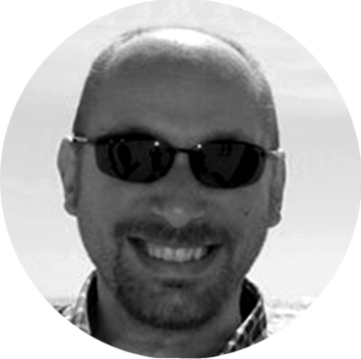
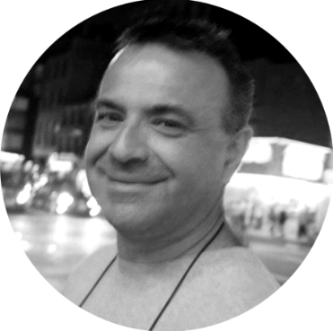
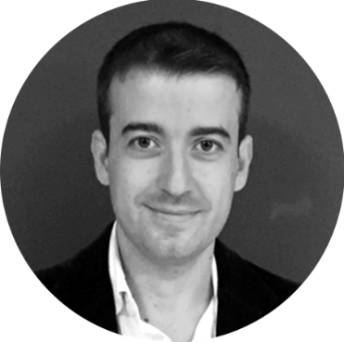
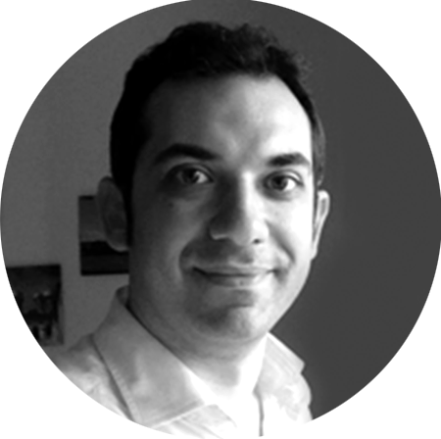
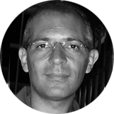
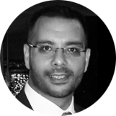
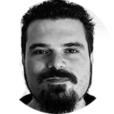
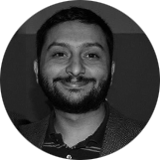
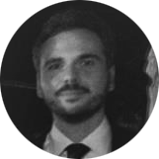
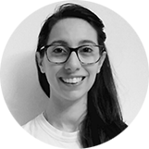
TEAM
Marco Sciuto
CEO
Giuseppe Patanè
CTO
Carlo Sciuto
CFO
Pierluigi Buttiglieri
COO
Marco Leotta
R&D Manager
Sebastiano Battiato
Computer
Vision Advisor
Giovanni Farinella
Computer
Vision Advisor
Daniele Maio
‘’Veteran’’
Developer
Daniele Di Mauro
Parksmart
Phd Student
Francesco Di Franco
Back-end
Developer
Benedetto Amata
Legal
Valeria Sciacca
Graphic Designer
www.parksmart.it
Notes:
This is our team!

Slide 3
COMPETITORS
LOW
INSTALLATION COSTS
MAINTENANCE COSTS
LOW
www.parksmart.it
Notes:
When we started to design the solution, we focused on which kind of architecture we needed to solve the issue in a fast and efficient way.
There are many competitors that use sensors plunged inside the asphalt, they can provide only one boolean information: parking space empty/not-empty.
These sensors have some issues as discovered by some customers, among the others we can count Trento's city. They said to us that at low temperature (many months during the year in Trentino), near 0 celsius degree these sensors don't work or give wrong informations.
Another huge issue is powering these sensors, they work with batteries and the duration of them is variable because affected by weather conditions. The maintenance costs are very expensive.
The advantage of our approach is that we use ip cameras as multi-sensors.
At this time we give the same informations of traditional sensors, but we will offer through software updates new services based on computer vision,
among the others we can:
- car counting,
- traffic analysis: in that way a public administration can manage in better way streets and public transportation.
- people counting: for example we can better estimate people streams during fixed periods (e.g. festival, etc)
- people safety: for example we could identify people who fall and generate an alert to be send to ER.

Slide 4
AWARDS
www.parksmart.it

Slide 5
PARTNER
www.parksmart.it

Slide 6
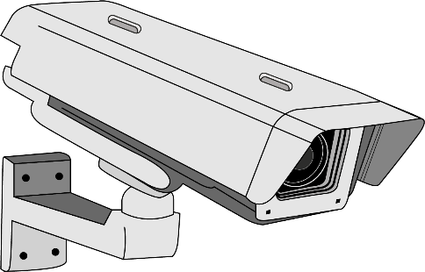
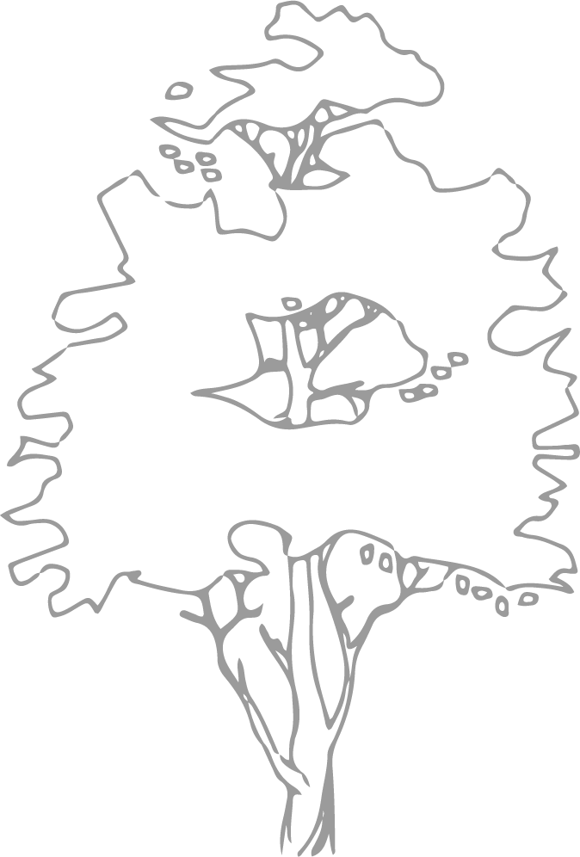
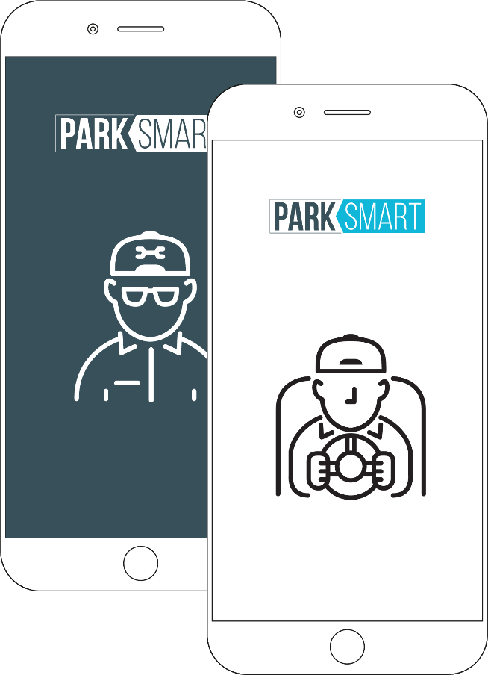
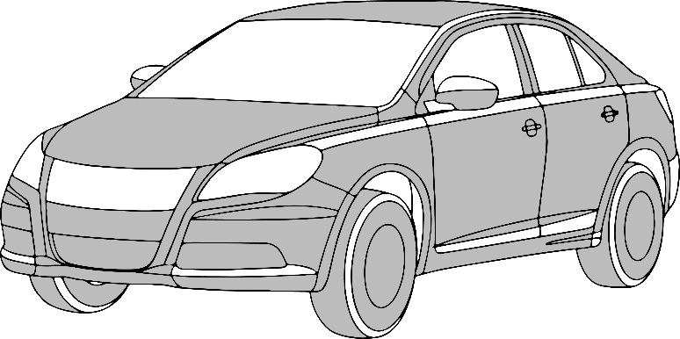
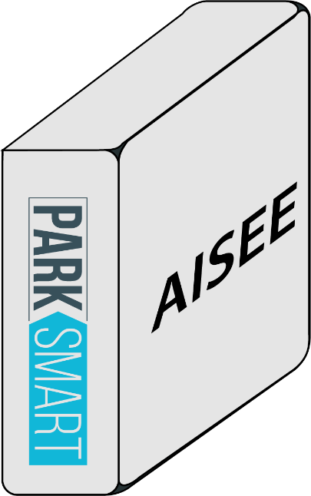
SOLUTION
CLOUD SERVER
Notes:
Some others competitors use ip camera like us, but they use a different kind of architecture based on video streaming from cameras to servers where they elaborates videos to extract the informations.
So, we tried to think in a disruptive way, putting an embedded IoT device near the camera to elaborate video in realtime and sending only text informations (e.g. JSON string) over internet, this method enable us to use any type of connections from narrowband (gsm) to broadband (fiber).
In this way we achieved different goals:
- reducing bandwidth needs of 95%! because we don't stream images or video
- elaborating video/images in place with artificial intelligence algorithms (machine learning) we avoid privacy problems (we don't store images after elaborations and there is no person watching at images to monitor the parking spaces).

Slide 7
RESEARCH / Investment
DEPLOY FIRST PILOT INFRASTRACTURE - Cittadella Universitaria
SPONSORSHIP A PhD GRANT - 3 years course
SERVER GPU – For deep learning research
SERVER – R&D
3 EMBEDDED DEVICES – Nvidia TK1
3 EMBEDDED DEVICES – Nvidia TX1
35k €
70k €
15k €
15k €
1,5k €
13k €
www.parksmart.it
Notes:
We have made several investments that it’s useful to do R&D and to test the platform.
In particular we invested on Research and sponsored a PhD Grant on Computer Vision.

Slide 8
RESEARCH RESULTS
SYSTEM AND METHOD FOR RECOGNITION OF PARKING STALLS AVAILABLE FOR A VEHICLE
LEARNING APPROCHES FOR PARKING LOTS CLASSIFICATION
PATENT APPLICATION
PCT/IB2016/053579
16 June 2016
In International Conference on Advanced Concepts for Intelligent Vision Systems, pp. 410-418. Springer International Publishing, 2016.
Di Mauro Daniele, Sebastiano Battiato, Giuseppe Patanè, Marco Leotta, Daniele Maio, and Giovanni M. Farinella.
www.parksmart.it
Notes:
We have a Patent application and we did the first publication in collaboration with our Scientific Advisors and our PhD student

Slide 9
JOINT PARTICIPATIONS / Parksmart and IPlab
Smart Cities
World Congress
Nvidia GPU
Technology Conference
ACIVS
Publication
ICVSS
2015
2016
2016
2016
2016
www.parksmart.it
Notes:
Some international events where we were in partneship with IPLab

Slide 10
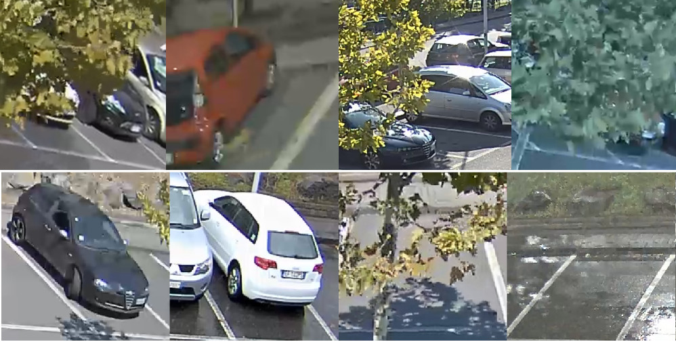
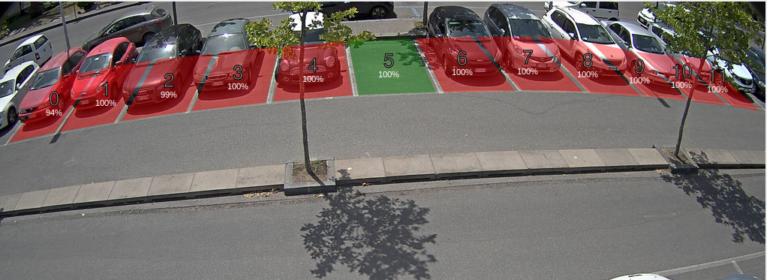
CURRENT SOLUTION
99%
ACCURACY
Developed in collaboration with IPlab, it use parking lots configuration and classify even are empty or not.
www.parksmart.it
Notes:
After 2 years of hard work, we have a good solution that work well in our Living Lab here in Cittadella.

Slide 11
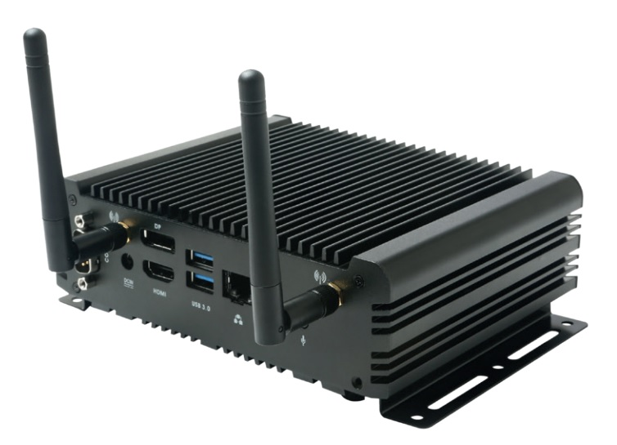
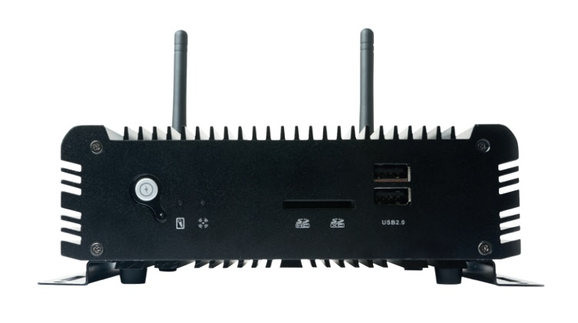
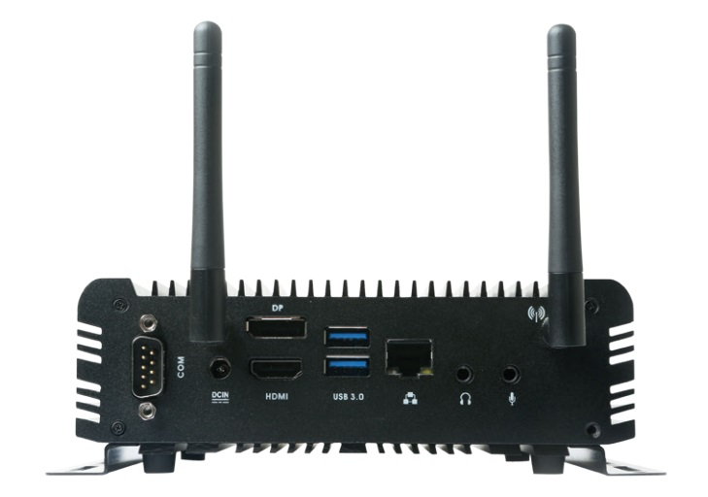
AISEE BOX and PSM OS
www.parksmart.it
Notes:
AISEE box is our IoT device, based on Nvidia Jetson TX1 SOM.
In order to have flexibility and full control of the operating system, we found the necessity of create our OS.
At first we would have preferred starting from scratch using a project like Linux From Scratch but we had some constraints:
Nvidia binary driver is, at the moment, distributed only for ubuntu
we needs to use the CUDA library, that is in binary form and compiled for ubuntu
It is still possible to create a Linux From Scratch compatible distro following these constraints, we should configure all packages with the same version of ubuntu 16.04;
in this way we could maintain ABI compatibility.
But in this way we have a distro very similar to ubuntu.

Slide 12
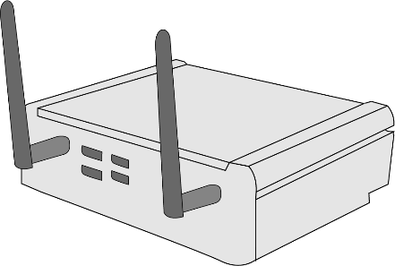
PSM OS
PSM IOT GATEWAY
PSM SOFTWARE UPDATE MANAGER
PSM
COMPUTER VISION MODULE
PSM
IOT GATEWAY
PSM RECOVERY & SOFTWARE UPDATE MANAGER
PSM RECOVERY SYSTEM
PSM OPERATING SYSTEM
AISEE HARDWARE
(ARM Based)
www.parksmart.it
Notes:
So why do this?
the binary produced doesn’t have particular optimization, because is ARM and not X86, so compilation flags is the same in ubuntu or LFS.
X86 architecture is based on CISC, a complete instruction set while ARM is based on RISC, a reduced instruction set.
So for X86, we have for every new process generation a new instruction set, so if you enable it at compile time, the binary generated is:
more optimized on execution time and memory consumption
not compatible with predecessor
As you know the main stream Linux Distributor for X86, uses compatibility compilation flags, so if you use a particular X86 like i7 for example, you need to enable particular CFLAGS to enable specific features!
But in this way the generated binary could run only on i7 processor.
All these consideration pushed us towards another direction:
we designed our OS based on Ubuntu Core 16.04 LTS, that is an ubuntu minimal distro designed for embedded devices, it is for arm/arm64, and starting from this point we have made some customizations:

Slide 13
PSM OS / FILE SYSTEM STRUCTURE
File System structure to support:
two firmware images:
one for recovery and firmware updates
one with full system
one partition for certificates
one partition for Computer Vision software and data
2
1
1
FIRMWARE
IMAGE
PARTITION
FOR
CERTIFICATES
PARTITION
FOR
COMPUTER VISION SOFTWARE AND DATA
One for recovery and firmware updates
One with full system
www.parksmart.it
Notes:
This File System structure permits to implement a robust software update system which help us to avoid problems during flashing operations when and if some dangerous event happen, e.g. when there is a power down during flashing.
All procedures to create firmware images are automated through bash scripts which download ubuntu packages, to build our software and to package it for distribution, to patch code in Kernel sources, u-Boot sources and on the scripts for flashing provided by Nvidia as BSP.
A variant of these procedures are used to create a toolchain for cross-compilation, that is used by our developers to build, to deploy and to test the software.

Slide 14
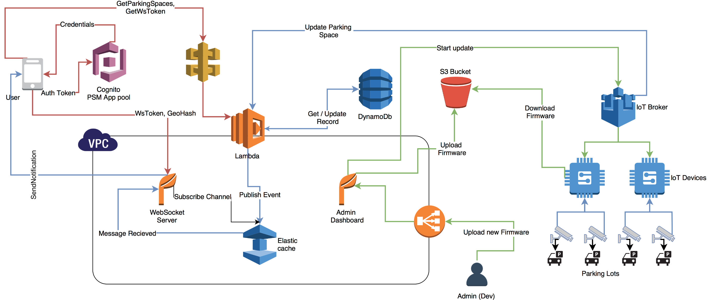
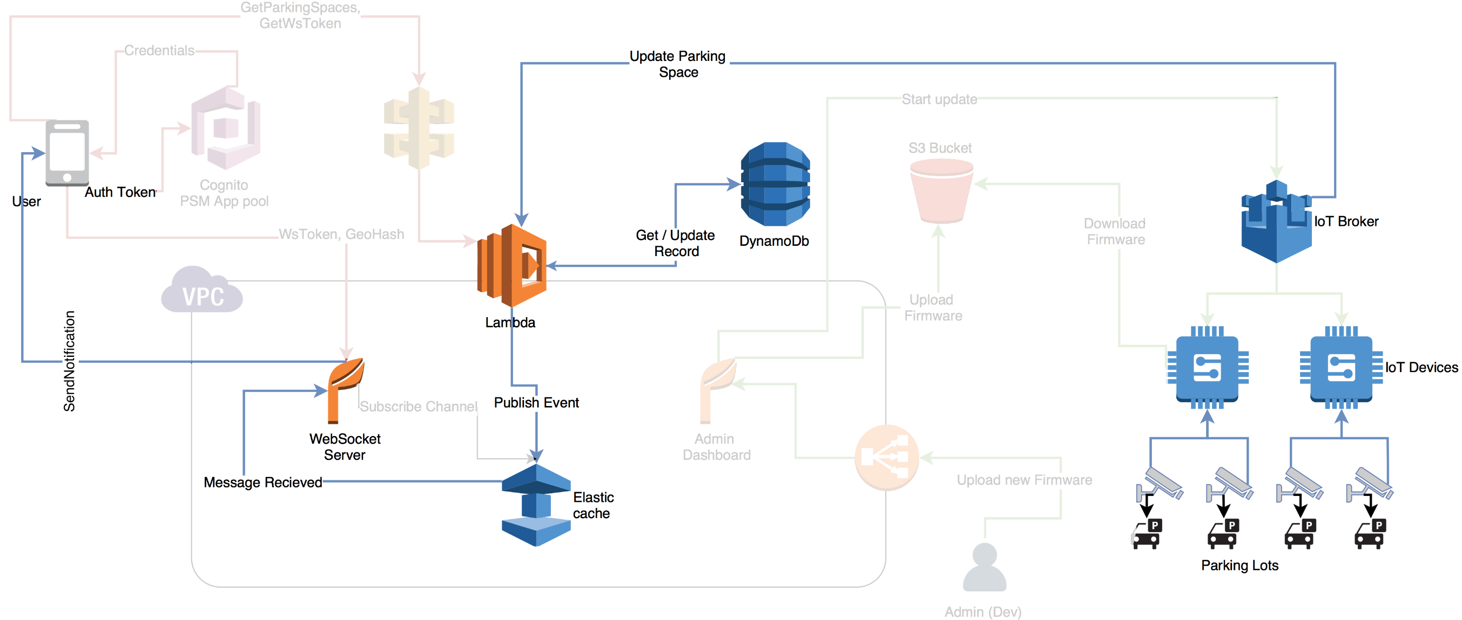
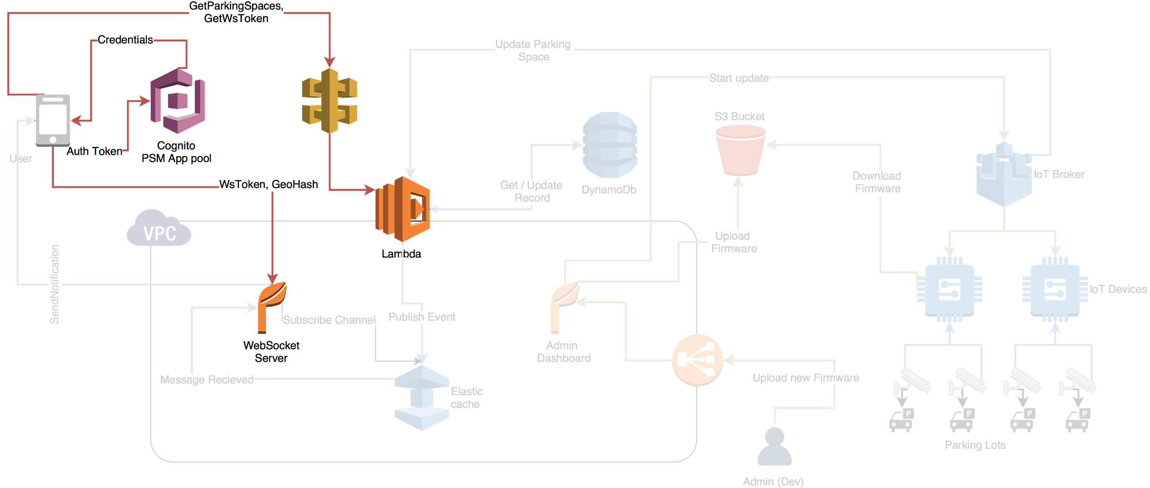
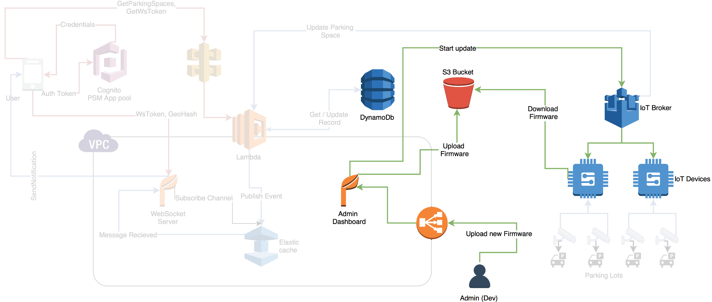
ARCHITECTURE
www.parksmart.it
Notes:
Now we can go in details of the Architecture
This is an high level diagram that describe 3 macro block on our architecture:
The first block is responsible to (blue):
Updates parking spaces status
The second block is responsible to (red):
authenticate user, send to the user after secure request the information about parking spaces near his position.
After this step, the user is connected with websocket services to receive realtime updates of parking status.
The third block is responsible to (green):
Manage AISEE box, software update and recovery updates.
Our Backend is microservices/serverless oriented and it is developed on Amazon Web Services.

Slide 15
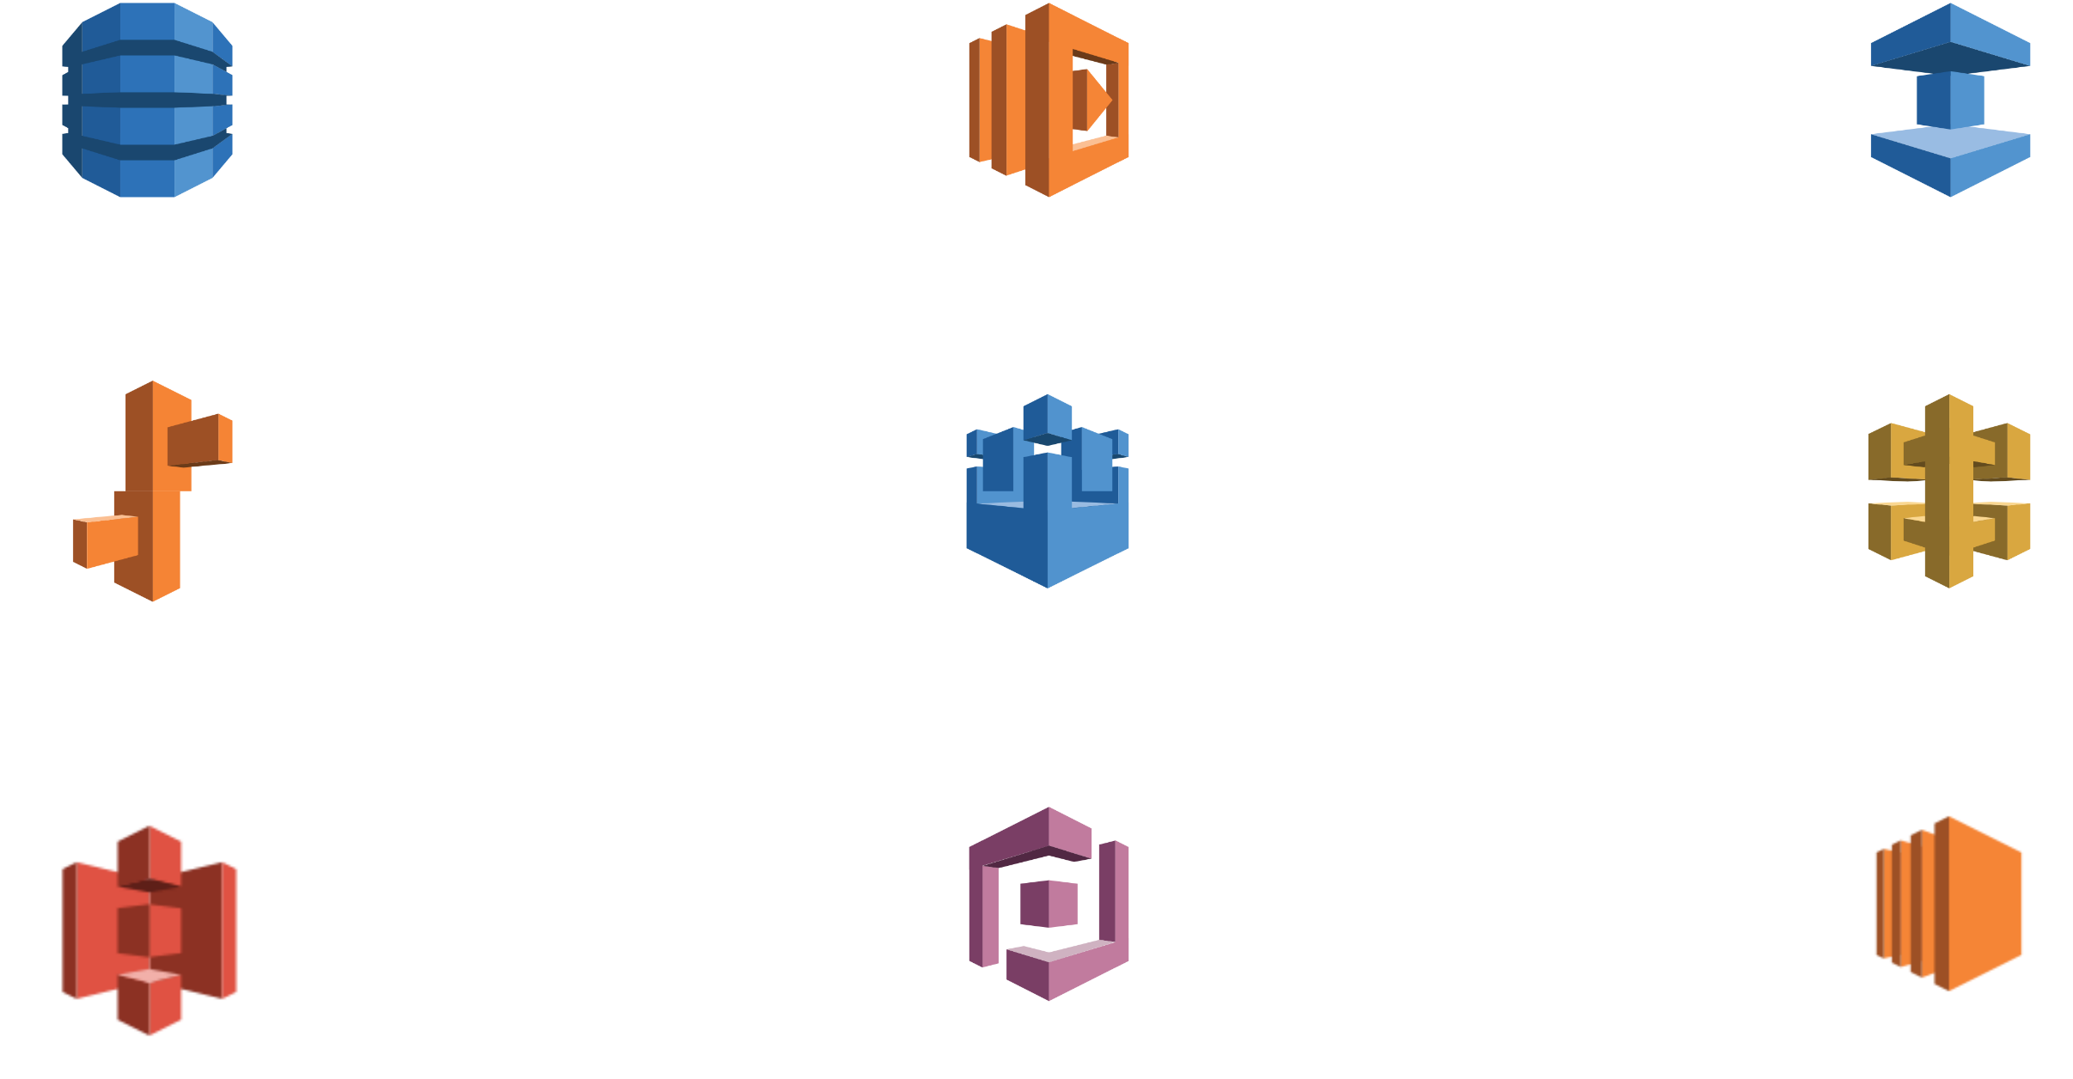
AWS USED IN PARKSMART
DynamoDB
Lambda
Elastic cache
Elastic beanstalk
AWS iot
API gateway
S3
Cognito
EC2
www.parksmart.it
Notes:
In particular from AWS, we use:
1 DynamoDB, a nosql database service
2 Lambda to create serverless event driven scripts
3 Elastic cache (redis cluster) to cache data and pass messages between services.
4 Elastic beanstalk, the container service managed from amazon, to create microservices (websocket service).
5 AWS iot to manage iot device: this service let you to manage X.509 certificates and communication between devices and our backend.
6 API gateway, fully managed api services built on lambda .
7 S3 to store files like firmwares
8 Cognito to manage and authenticate users
9 EC2 To instatiate testing and debug VM

Slide 16
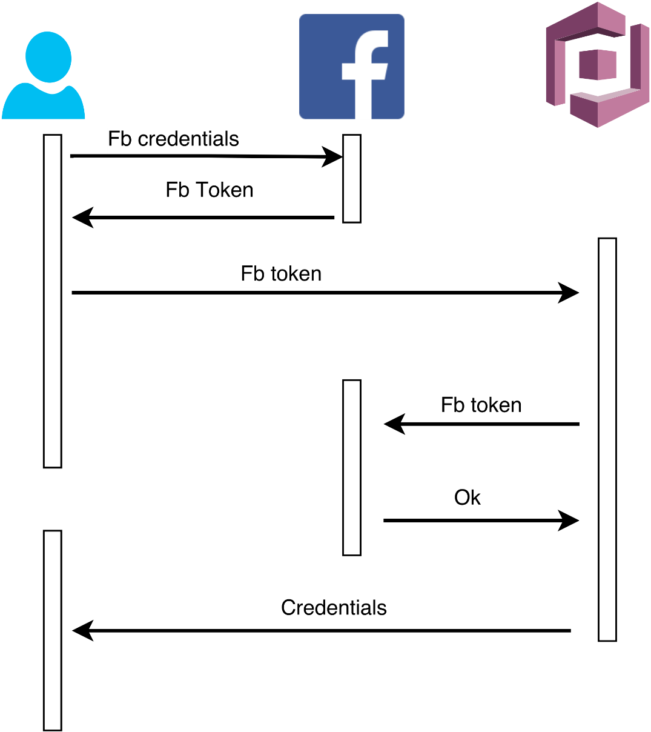
USER AUTH WITH AWS / COGNITO
www.parksmart.it
Notes:
In parksmart there are many groups of users:
Admins
Companies admin
Installers
Inspectors
mobile app users
To manage all groups we use a service provided by AWS named Cognito that allow to use different permissions for each group.
Every user, after having logged in with the credentials provider (parksmart for admin, companies and inspector - facebook, google, twitter and parksmart for mobile app users) will receive the following credentials:
aws access key id : unique id associated with the user
aws secret access key: a secret key for the user
cognito token: a token valid for 6 hours (5760 bit -> 720 chars)
Each group can perform different action associated to the group:
e.g.
Admin can create a company and user inside all group.
An inspector can check the payment status for the cars inside the geographical area of the companies where he work.

Slide 17
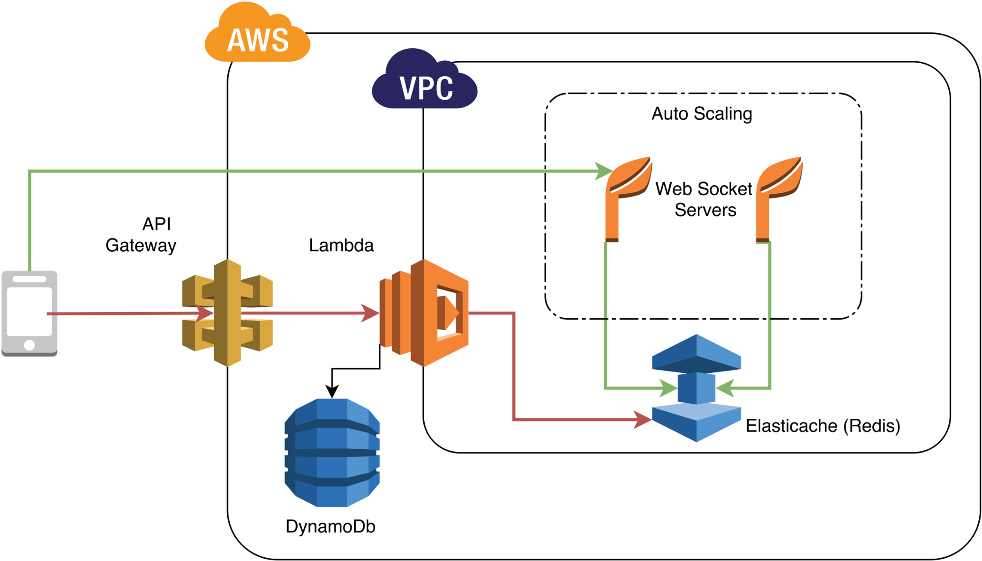
USER AUTH WITH AWS / COGNITO
www.parksmart.it
Notes:
A mobile app user can only retrieve the information about parking lots near her position.
All APIs except the admin dashboard are implemented with serverless technologies (api gateway + lambda) that allows auto scaling and zero infrastructure management.
Each api request is signed with the secret access key and the token is used as freshness warranty. In AWS, when a request is authenticated, the system will check the associated execution role ( a set of a security policy) to know which resources that can be accessed by the user.

Slide 18
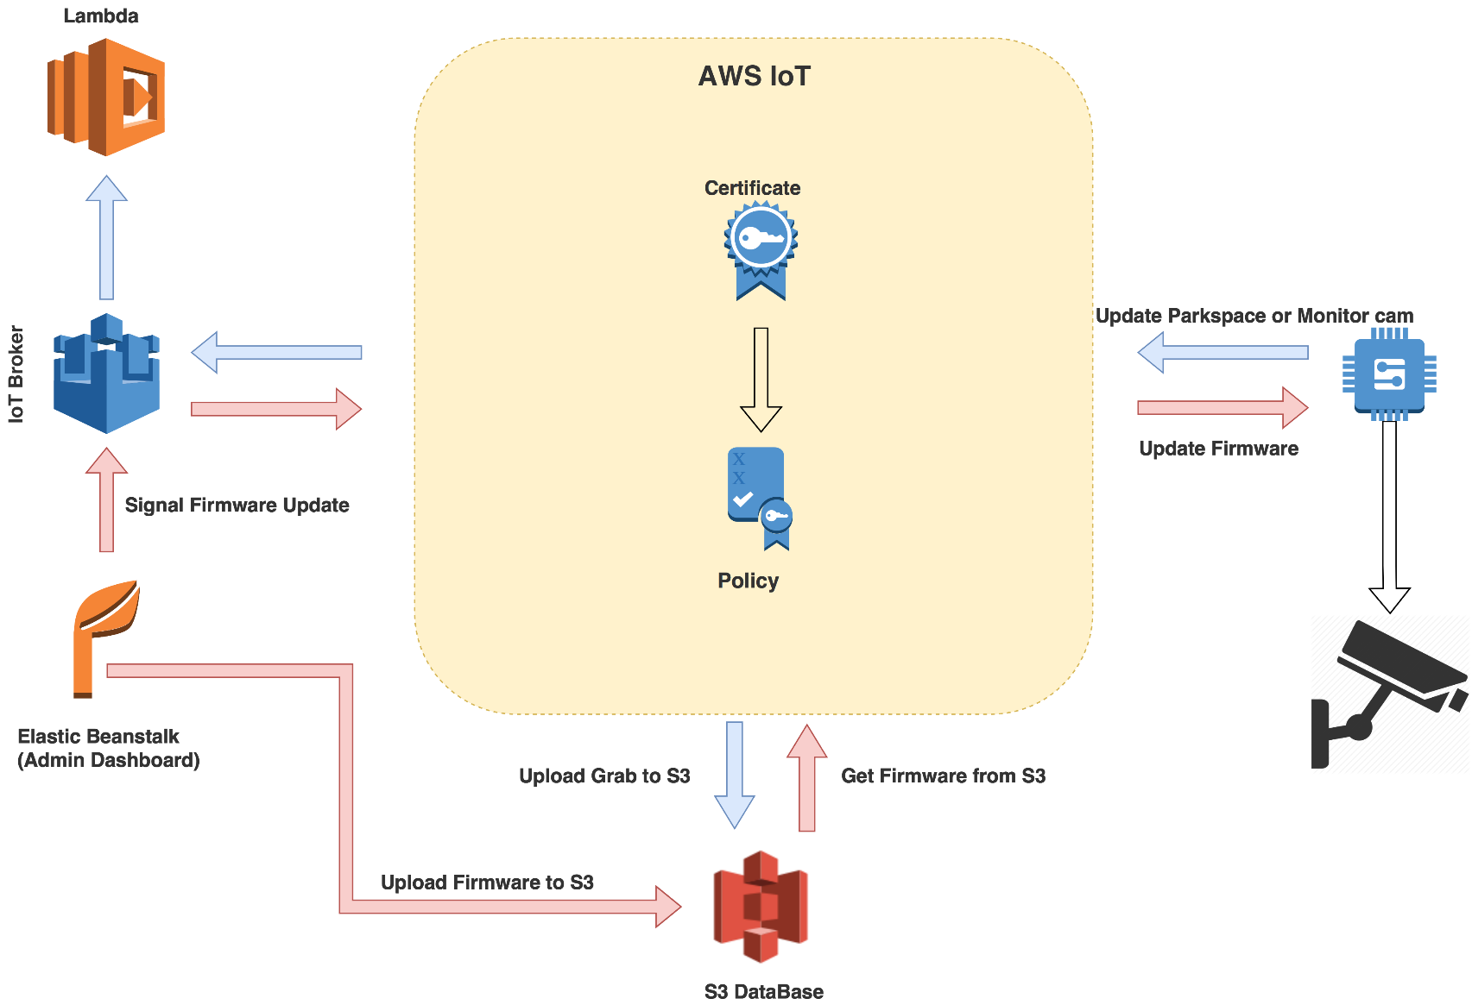
IOT GATEWAY
www.parksmart.it
Notes:
In this diagram is described how AISEE communicate with Backend using AWS IoT and X.509 certificates.
To avoid security problems, we have no running services on the IoT devices.
The SSH service is enabled only on development firmware and disabled on production.
We developed a daemon written in C++ that work as a client for the Backend.
This client use X.509 certificate to communicate with Backend.
For the communication this daemon use a publisher/subscriber protocol, called MQTT, over a secure channel encrypted with ssl/tls.
Every board is authenticated by a unique X.509 certificate.
When a board try to connect to AWS, the broker will check if the certificate is active.
Every certificates is associated with a policy that describe all actions that the board can do:
- the id that can be used for the connection.
- the topic where the board can subscribe
- the topic where the board can publish
- the topic where the board can receive messages
It’s important to underline that subscriber action is different to receive messages action

Slide 19
USER NOTIFICATIONS / PRIVACY
www.parksmart.it
Notes:
From the camera, our software on the AISEE box take a frame, then elaborates it on AISEE, extract only information like:
Parkspace, position, status
And send this info to the backand.
So no one (human) can see images captured.

Slide 20
USER NOTIFICATIONS / PRIVACY
www.parksmart.it
Notes:
To notificate a user, we don’t need the geographical position with high precision.
We use a geographical clustering called geohash.
In geohash notation a position (lat, lng couple) is recognized by a bit sequence where in max precision (40 bits) we have 16 meters of error.
Actually we are using 30 bits to recognize the user inside an area of 1,2 square kilometers.

Slide 21
Life is what happens to others while
you are looking for parking
www.parksmart.it

Slide 22
